Slide 1
Network

Slide 2
Network
What is Network
Postman
Code
Okhttp
Retrofit
Security

Slide 3
What is Network
Dynamic Content
Online Static Content
Images
Data
Video
HTML

Slide 4
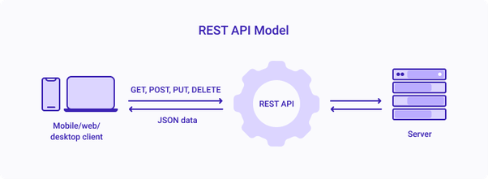
Network
Rest API
CRUD
C - Create - POST
R - Read - GET
U - Update - PUT
D - Delete - DELETE
Data Type: JSON
Web Services
Data Type: XML

Slide 5
Mobile Network Steps
API - Service
Postman
Java Request
POJO
Serialize
Other BL

Slide 6
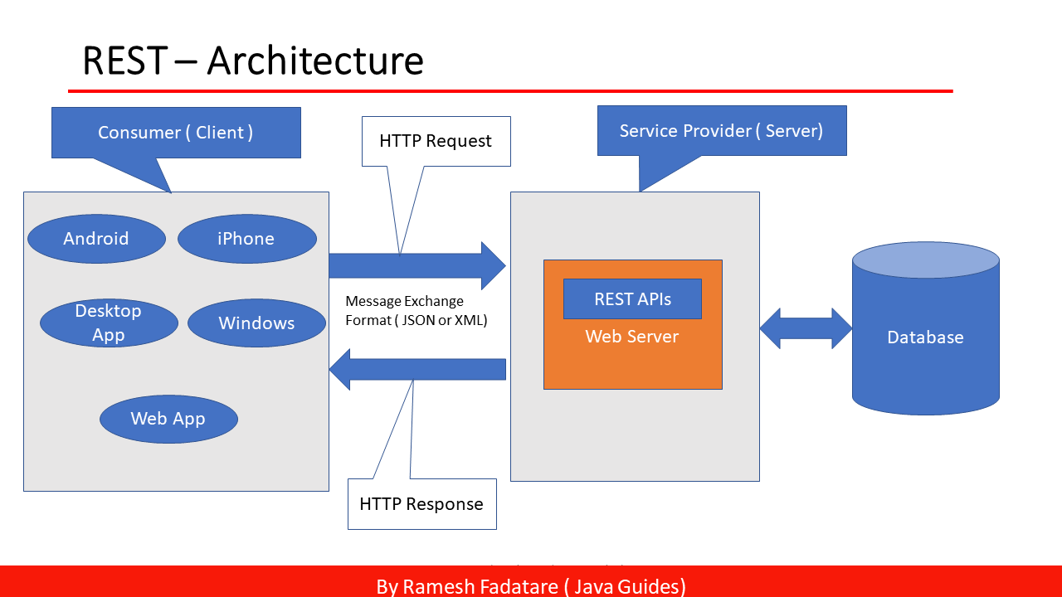

Slide 7
Mobile Network Life Cycle
API
Postman
Java Request
POJO
Serialize
Other BL

Slide 8
Postman
Postman is an API platform for building and using APIs. Postman simplifies each step of the API lifecycle and streamlines collaboration so you can create better APIs—faster.

Slide 9
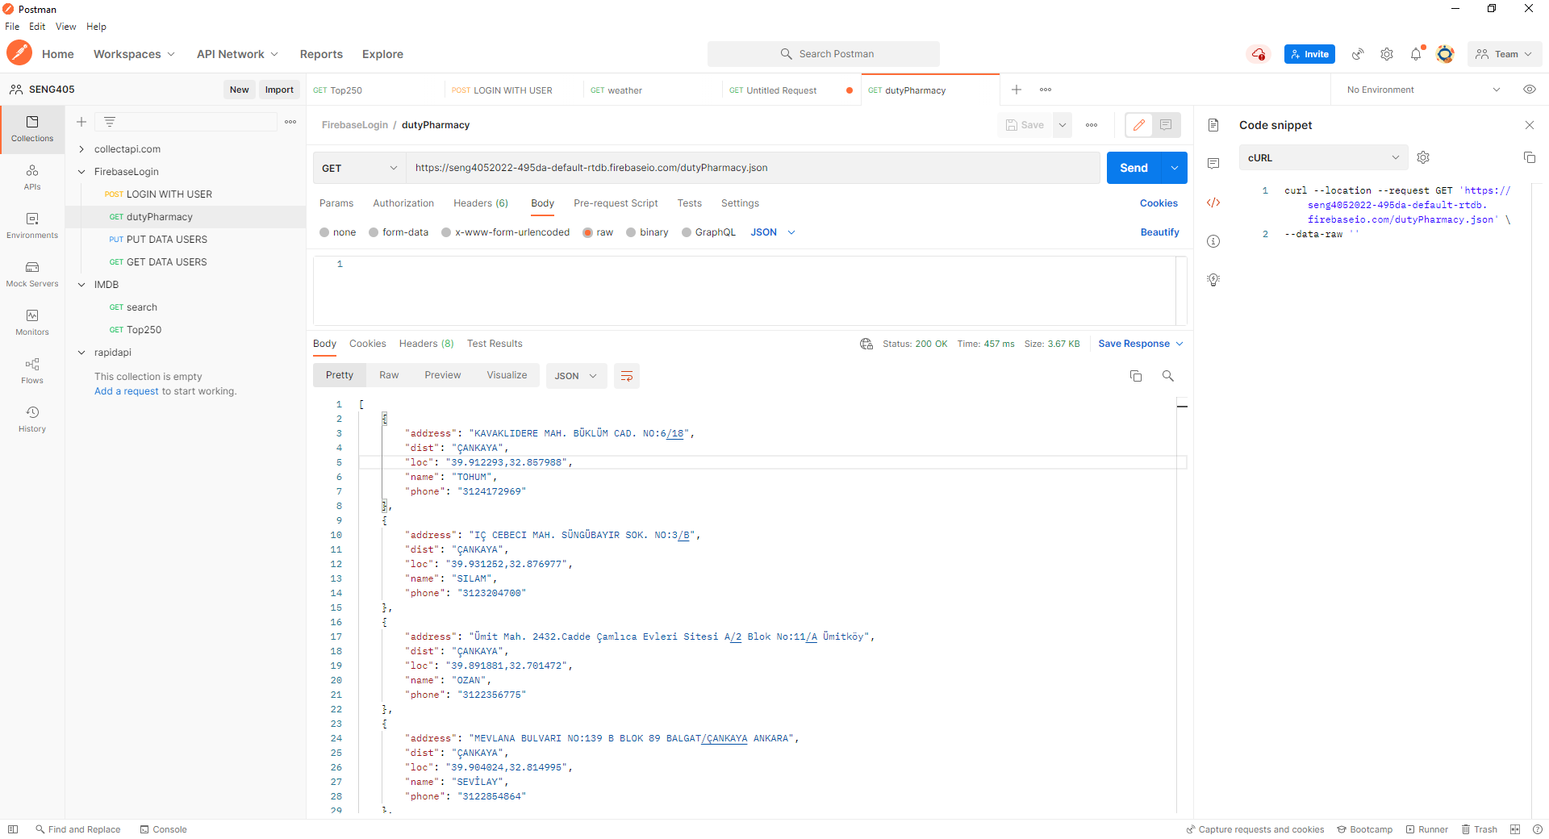
2
5
4
1
3

Slide 10
1

Slide 11
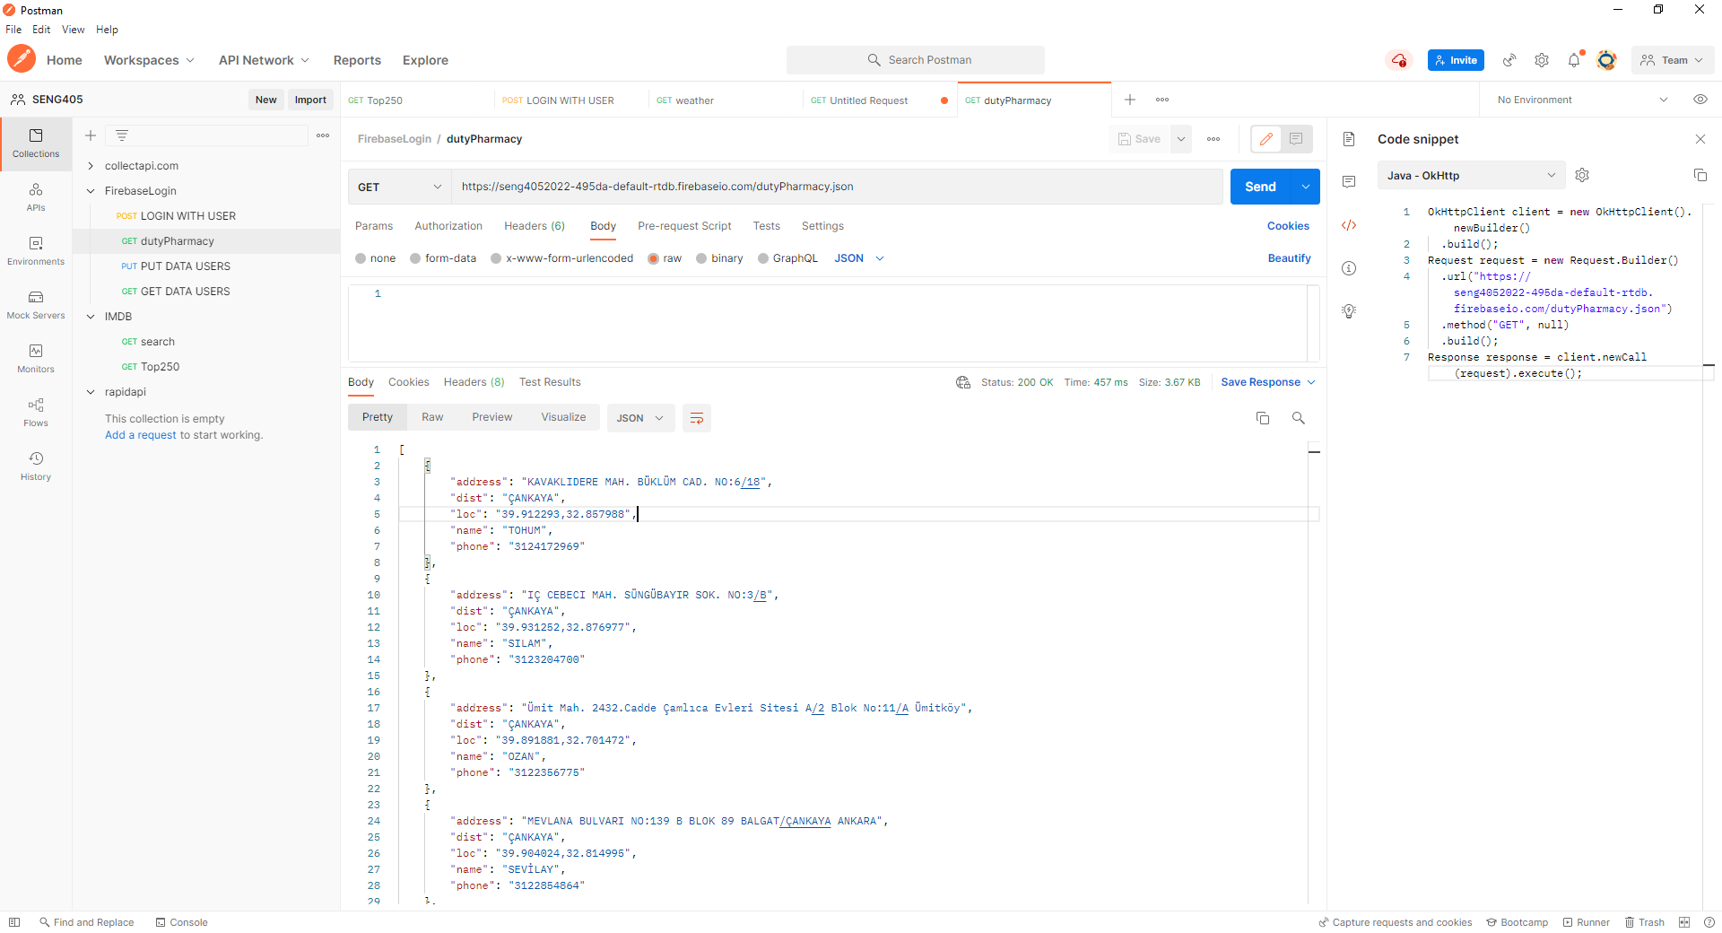
Collections

Slide 12
2

Slide 14
3

Slide 16
4

Slide 18
cURL
cURL is a command-line tool for getting or sending files using URL syntax. Since cURL uses libcurl, it supports the same range of common Internet protocols that libcurl does.

Slide 19
5

Slide 20
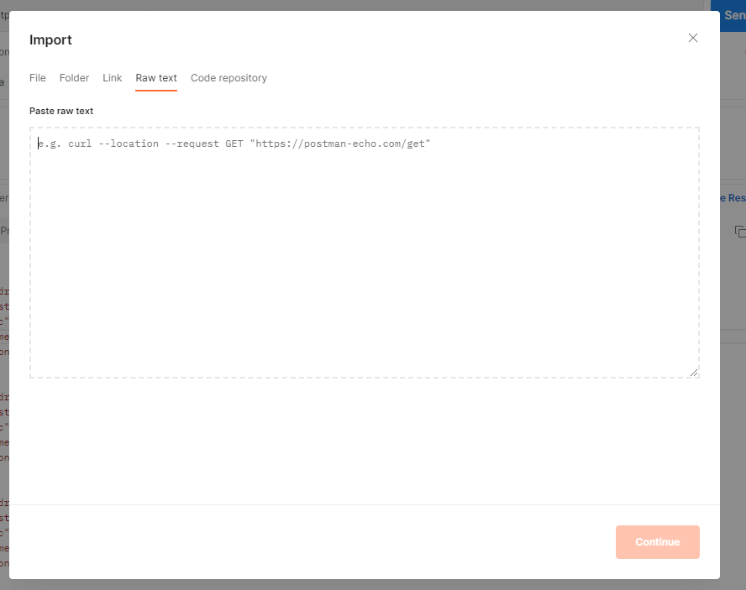
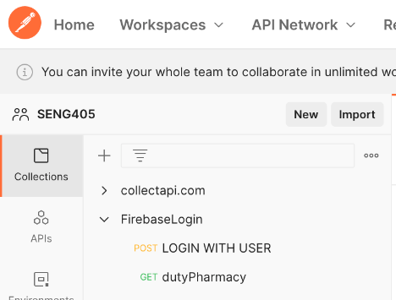
Import

Slide 21
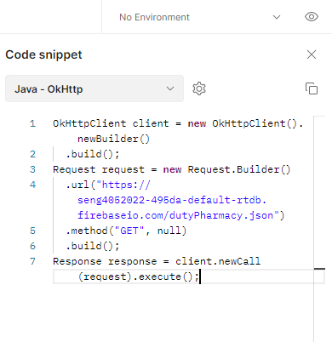

Slide 22


Slide 23
Mobile Network Life Cycle
API
Postman
Java Request
POJO
Serialize
Other BL

Slide 24
Connect to Network - Android
Most Android applications have some data that the user interacts with; it might be news articles, weather information, contacts, game data, user information, and more. Often, this data is provided over the network by a web API.

Slide 25
Thread
A thread is an execution context, which is all the information a CPU needs to execute a stream of instructions.
UI Thread: When an Android app starts, it creates the main thread, which is often called the UI thread. The UI thread dispatches events to the appropriate user interface (UI) widgets. The UI thread is where your app interacts with components from the Android UI toolkit (components from the android.widget and android.view packages).
Android's thread model has two rules:
Do not block the UI thread.
Do UI work only on the UI thread.
The UI thread needs to give its attention to drawing the UI and keeping the app responsive to user input. If everything happened on the UI thread, long operations such as network access or database queries could block the whole UI. From the user's perspective, the app would appear to hang. Even worse, if the UI thread were blocked for more than a few seconds (about 5 seconds currently) the user would be presented with the "application not responding" (ANR) dialog. The user might decide to quit your app and uninstall it.
Processes and threads overview | Android Developers ANRs | Android Developers Keeping your app responsive | Android Developers

Slide 26
Worker threads
Because of the single threaded model described above, it's vital to the responsiveness of your application's UI that you do not block the UI thread. If you have operations to perform that are not instantaneous, you should make sure to do them in separate threads ("background" or "worker" threads).
However, note that you cannot update the UI from any thread other than the UI thread or the "main" thread.
To fix this problem, Android offers several ways to access the UI thread from other threads. Here is a list of methods that can help:
Activity.runOnUiThread(Runnable)
View.post(Runnable)
View.postDelayed(Runnable, long)

Slide 27
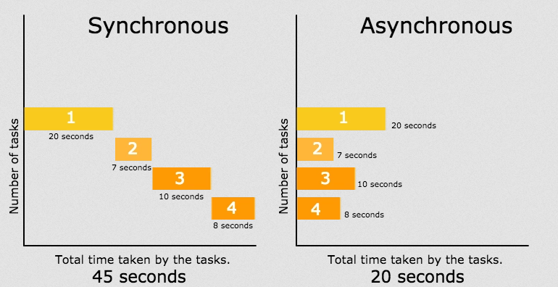
Async

Slide 28
AsyncTask (This class was deprecated in API level 30)
A worker thread is any thread which is not the main or UI thread. Use the AsyncTask class to implement an asynchronous, long-running task on a worker thread. AsyncTask allows you to perform background operations on a worker thread and publish results on the UI thread without needing to directly manipulate threads or handlers.
When AsyncTask is executed, it goes through four steps:
onPreExecute() is invoked on the UI thread before the task is executed. This step is normally used to set up the task, for instance by showing a progress bar in the UI.
doInBackground(Params...) is invoked on the background thread immediately after onPreExecute() finishes. This step performs a background computation, returns a result, and passes the result to onPostExecute(). The doInBackground() method can also call publishProgress(Progress...) to publish one or more units of progress.
onProgressUpdate(Progress...) runs on the UI thread after publishProgress(Progress...) is invoked. Use onProgressUpdate() to report any form of progress to the UI thread while the background computation is executing. For instance, you can use it to pass the data to animate a progress bar or show logs in a text field.
onPostExecute(Result) runs on the UI thread after the background computation has finished. The result of the background computation is passed to this method as a parameter.
AsyncTask | Android Developers

Slide 29
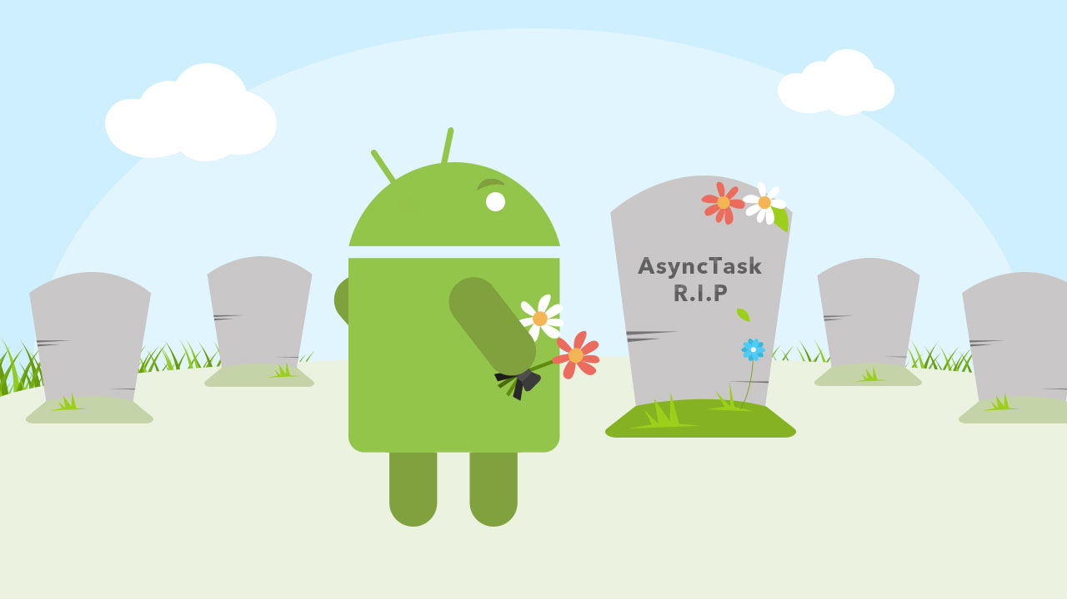
This class was deprecated in API level 30. Why?
AsyncTask was intended to enable proper and easy use of the UI thread. However, the most common use case was for integrating into UI, and that would cause Context leaks, missed callbacks, or crashes on configuration changes. It also has inconsistent behavior on different versions of the platform, swallows exceptions from doInBackground, and does not provide much utility over using Executors directly.

Slide 30
Network Android

Slide 31
Including permissions in the manifest
Before your app can make network calls, you need to include a permission in your AndroidManifest.xml file. Add the following tag inside the <manifest> tag: <uses-permission android:name="android.permission.INTERNET" />
When using the network, it's a best practice to monitor the network state of the device so that you don't attempt to make network calls when the network is unavailable. To access the network state of the device, your app needs an additional permission: <uses-permission android:name="android.permission.ACCESS_NETWORK_STATE" />

Slide 33
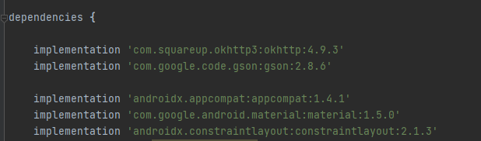
Network Call
GitHub - google/gson: A Java serialization/deserialization library to convert Java Objects into JSON and back
Overview - OkHttp
GitHub - square/okhttp: Square's meticulous HTTP client for the JVM, Android, and GraalVM.

Slide 34
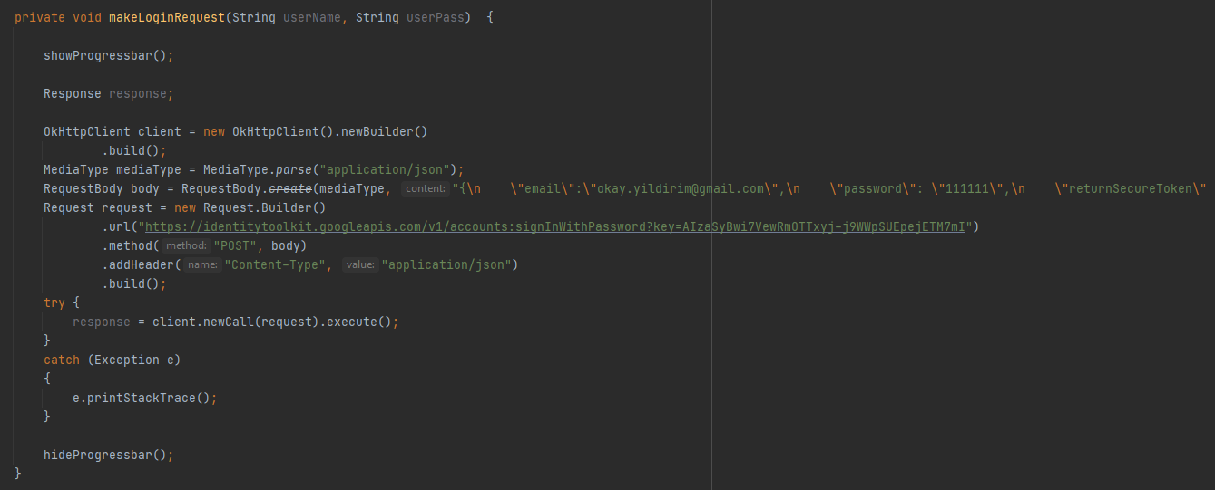
Network Call

Slide 35
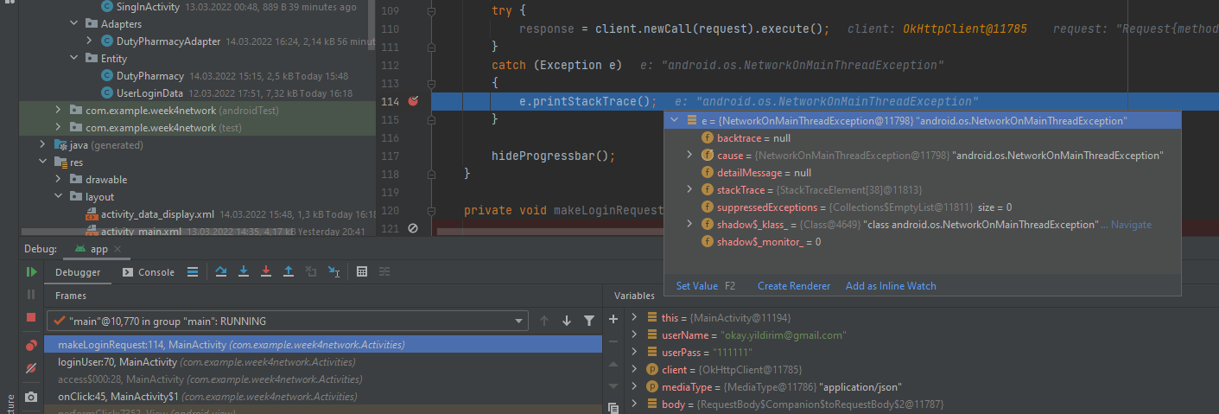
What Happens If Network Call Runs on UI Thread?
1
2

Slide 36
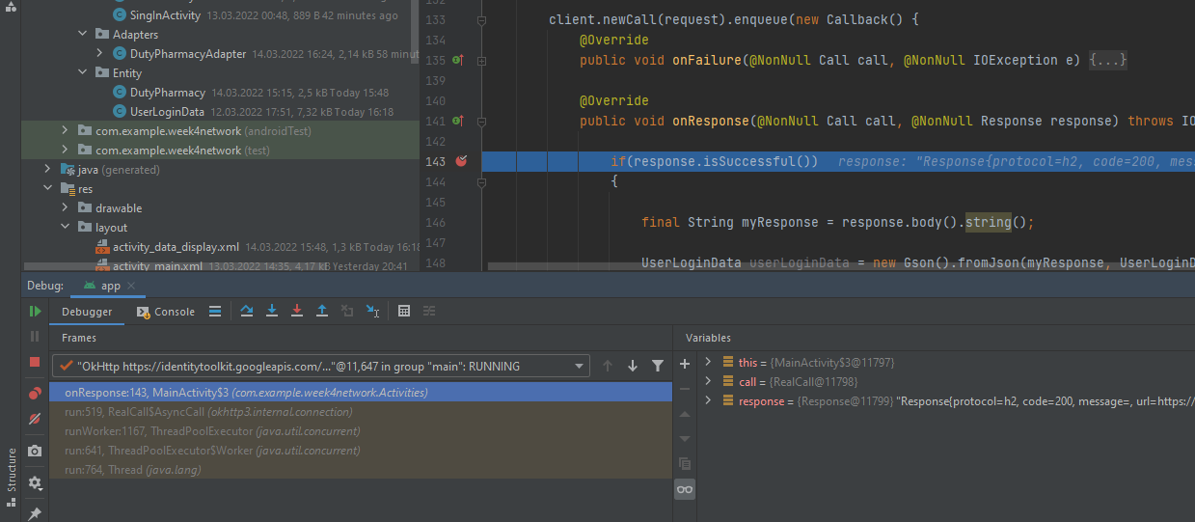
New Thread?
1

Slide 37
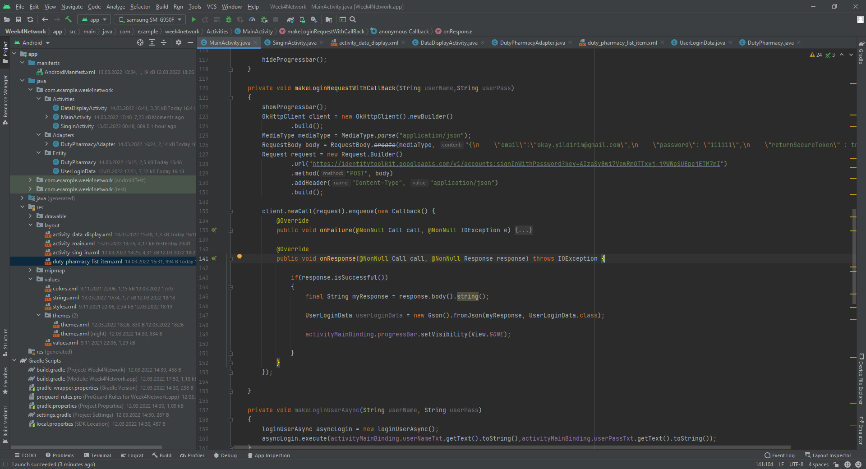
What Happens If View Call Out side of UIThread

Slide 38
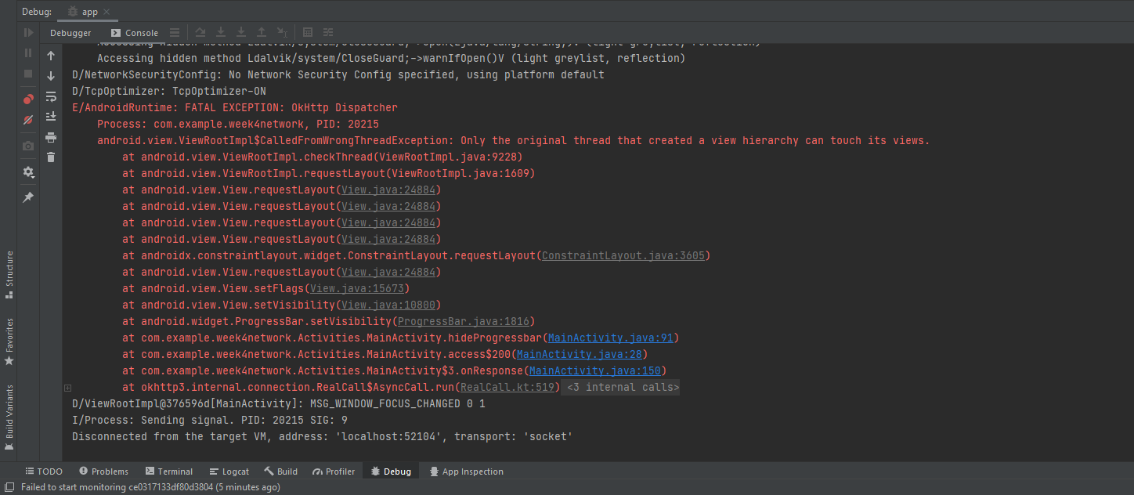
What Happens If View Call Out side of UIThread

Slide 39
Worker threads
Because of the single threaded model described above, it's vital to the responsiveness of your application's UI that you do not block the UI thread. If you have operations to perform that are not instantaneous, you should make sure to do them in separate threads ("background" or "worker" threads).
However, note that you cannot update the UI from any thread other than the UI thread or the "main" thread.
To fix this problem, Android offers several ways to access the UI thread from other threads. Here is a list of methods that can help:
Activity.runOnUiThread(Runnable)
View.post(Runnable)
View.postDelayed(Runnable, long)

Slide 40
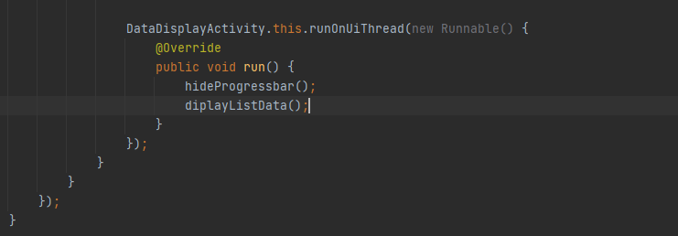
What Happens If View Call Out side of UIThread

Slide 41
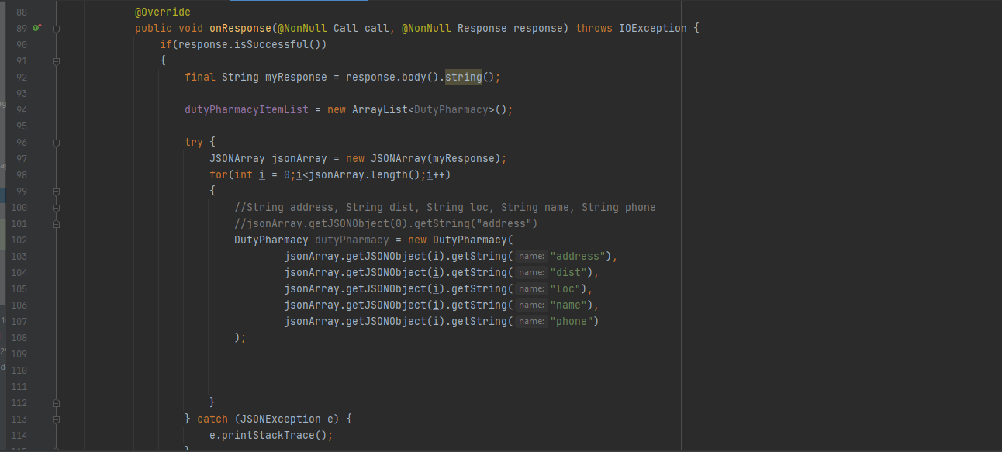
Parse Data

Slide 42
Mobile Network Life Cycle
API
Postman
Java Request
POJO
Serialize
Other BL

Slide 43
POJO Plain Old Java Object
Android: Jsonschema2pojo
IOS: App Quicktype

Slide 44
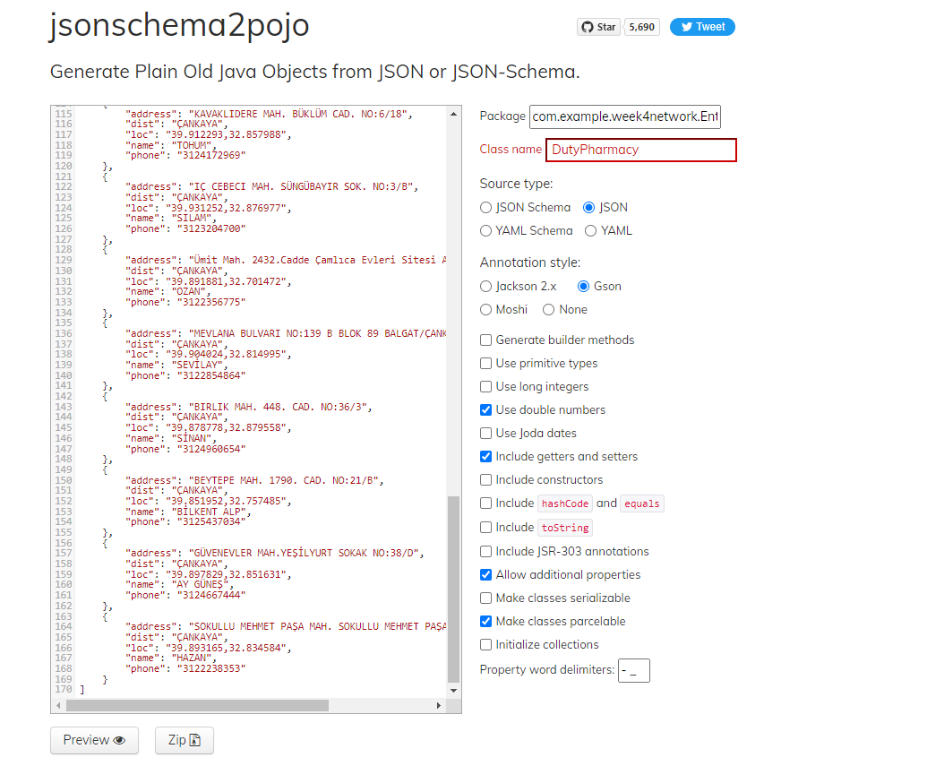

Slide 45
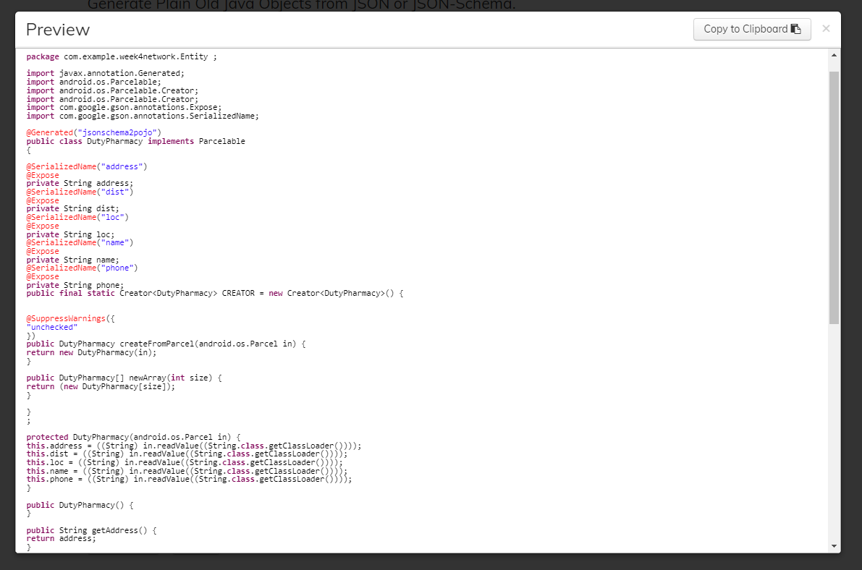

Slide 46
Mobile Network Life Cycle
API
Postman
Java Request
POJO
Serialize
Other BL

Slide 47
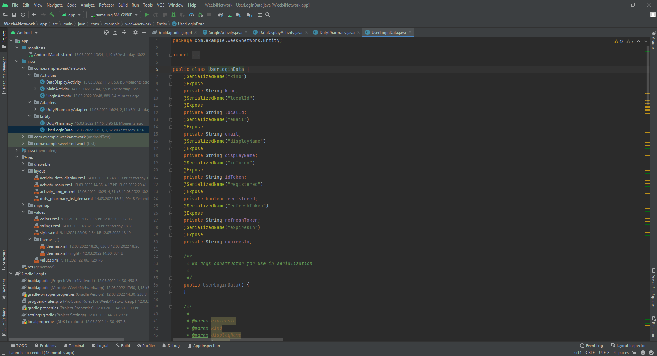
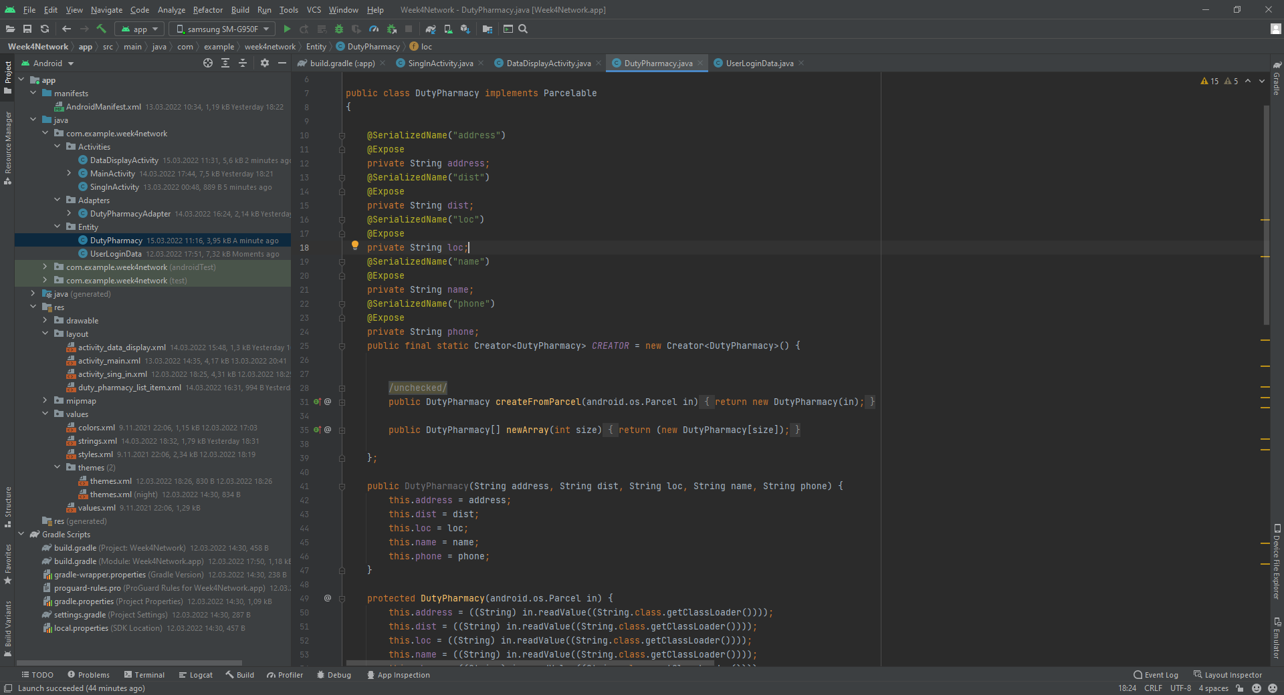

Slide 48
Parse JSON Simple Way - GSON

Slide 49
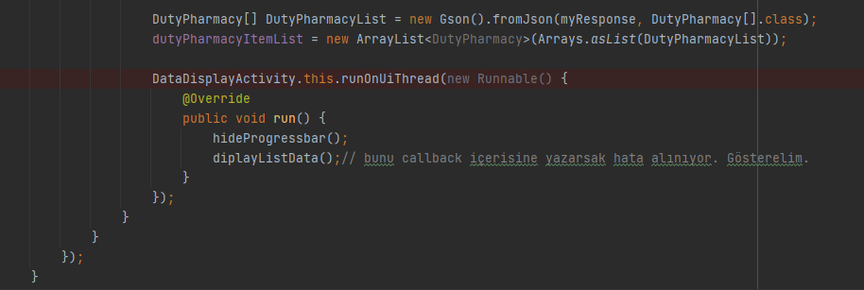
Parse JSON Simple Way - GSON

Slide 50
Network security
Network transactions are inherently risky, because they involve transmitting data that could be private to the user. People are increasingly aware of these risks, especially when their devices perform network transactions, so it's very important that your app implement best practices for keeping user data secure at all times.

Slide 51
Capture Network Traffic

Slide 52
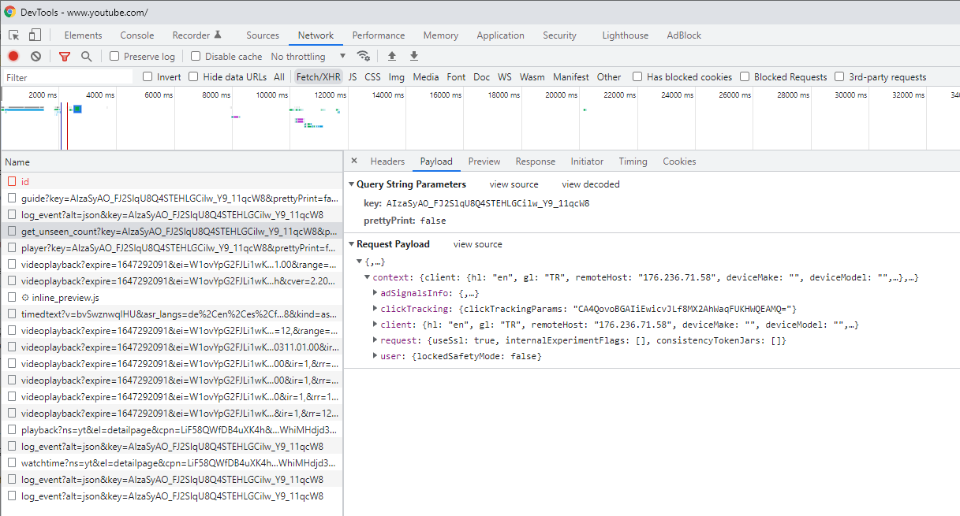
Chrome Developer Tool

Slide 53
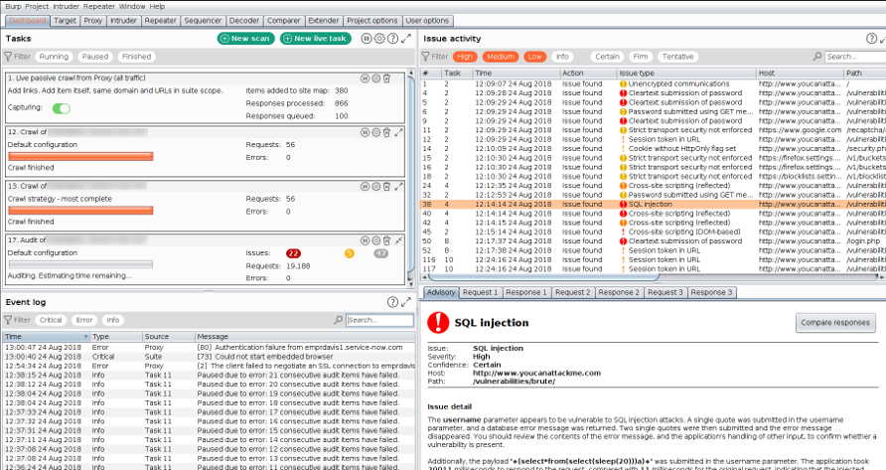
Burp Suit

Slide 54
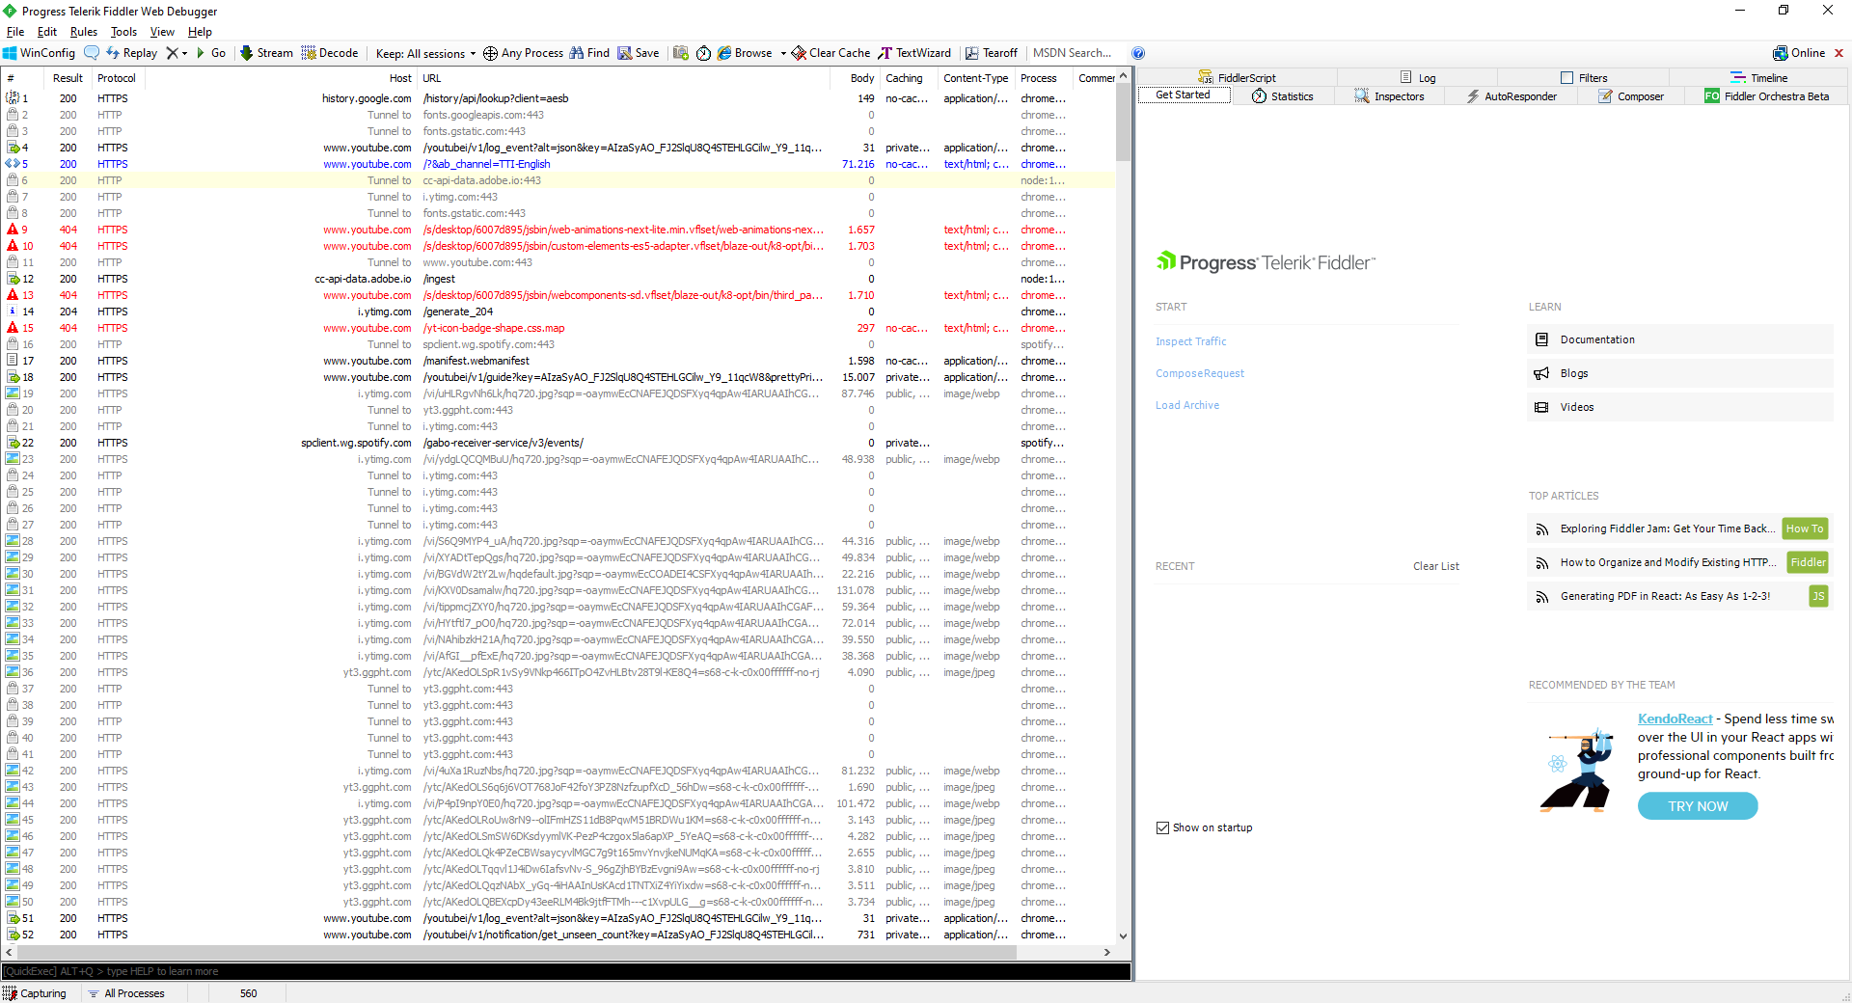
Fiddler

Slide 55
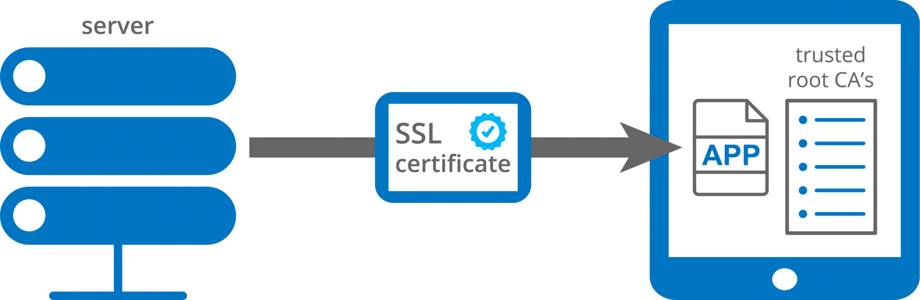
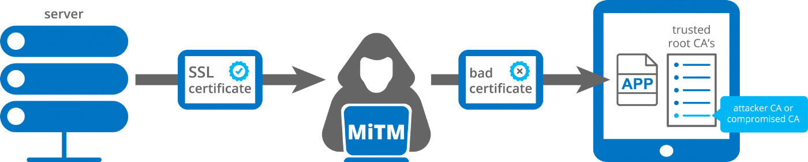
M.I.T.M.

Slide 56
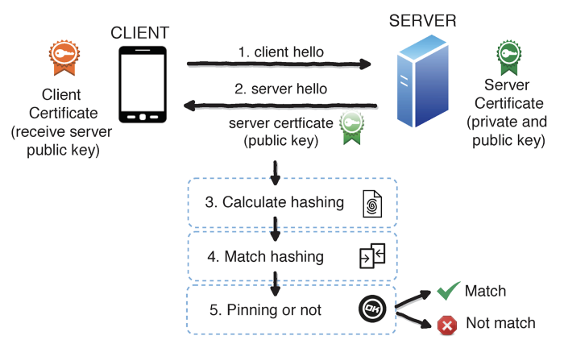
SSL Pinning
SSL: Secure Sockets Layer.
SSL Pinning: SSL pinning is a process of associating a host with their expected X509 certificate or public key. Once a certificate or public key is known or seen for a host, the certificate or public key is associated or ‘pinned’ to the host. If more than one certificate or public key is acceptable then advertised identity must match one of the elements in the certificate chainset. This allows the application to trust only the valid or pre-defined certificates or public Keys. We should use SSL pinning technique as an additional security layer for application traffic and to validate the remote host’s identity. If we do not implement SSL Pinning, application trusts custom certificate and allows proxy tools to intercept the traffic.
What is X.509 certificate: X.509 is a standard format for public key certificates, digital documents that securely associate cryptographic key pairs with identities such as websites, individuals, or organizations.
SSLSocket | Android Developers
https://developer.android.com/training/articles/security-ssl
SSL Pinning in Android. How to achieve SSL pinning? | by Apurv Pandey | Medium.

